Slide 1


Smart Energy Meter for Domestic Usages
AY 2021-25
GITAM UNIVERSITY
Major Project
Project ID: Alpha 10(P2)
A University should be a place of light, of liberty, and of learning.
Department of Electrical Electronics and Communication Engineering
Project Team:
BU21EECE0100524 Sudeep B S
BU21EECE0100553 Lakshman B H
BU21EECE0100574 Darshan D M
Project Mentor:
Dr. P Sundararaman
www.gitamedu.com

Slide 2




Project Group – Details
Photo
Track
Roll No
Name
EECE Regular
BU21EECE0100524
Sudeep B S
EECE Regular
BU21EECE0100553
Lakshman B H
EECE Regular
BU21EECE0100574
Darshan D M

Slide 3
Introduction
The Smart Energy Meter Project aims to transform energy consumption management by integrating advanced metering infrastructure (AMI) with real-time data analytics, enabling seamless monitoring and control in both residential and commercial settings. Equipped with IoT capabilities, the meter allows remote access to electricity usage data, providing valuable insights to both consumers and utility providers while reducing the need for manual effort. It supports dynamic pricing models, helping users optimize energy consumption by leveraging off-peak rates and lowering their bills. The system employs secure data transmission protocols to protect energy data and enhances grid resilience through predictive maintenance and timely alerts, preventing outages and ensuring a stable energy supply. With a user-friendly interface, the project empowers consumers to monitor their energy usage easily and adopt energy-saving practices, contributing to a smarter, more efficient, and sustainable energy future.

Slide 4
Objective and Goals
Objective
The primary goal of a smart energy meter for domestic usage is to provide real-time method for tracking, measuring, and controlling household energy consumption. These meters are designed to boost energy efficiency, minimize waste, and give users greater control over their electricity usage.
Real-Time Monitoring: Provides real-time data on electricity consumption to track usage.
Energy Efficiency: Helps optimize and reduce energy consumption by offering insights.
Accurate Billing: Ensures precise measurement of energy use for error-free billing.
Cost Savings: smart energy meters contribute to reducing energy bills and operational costs.
Goals
Main Goals:
Efficient Energy Management
Cost Savings
Energy Usage Transparency
Accurate Billing
Additional Goals:
Smart Home Integration:
Data Analytics and Insights:

Slide 5
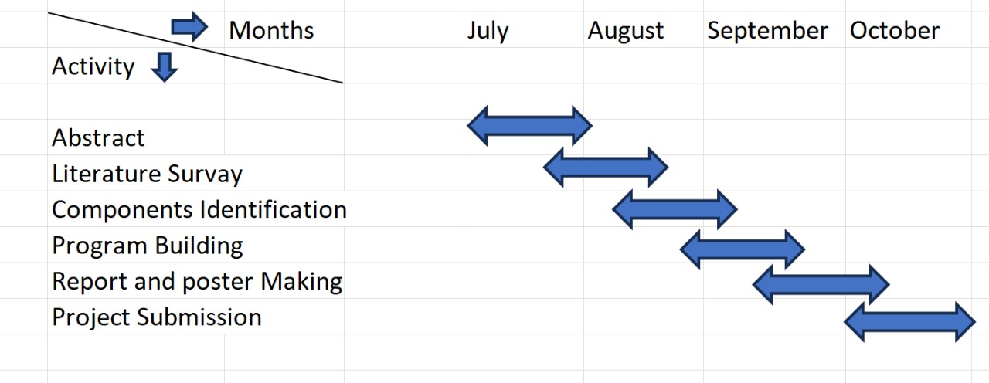
Project Plan

Slide 6
Literature Survey
SI NO | Title of the Paper (research paper) | Year | Author | Key Findings | Research gap
1. | DESIGN AND IMPLEMENTATION OF SMART ENERGY METER | 2022 | V. Preethi and G. Harish | Technology Utilization: The smart energy meter design leverages IoT technology, particularly using microcontrollers and wireless communication modules, to enable remote monitoring and management of energy consumption. Real-Time Monitoring: The system allows for real-time energy monitoring, providing both consumers and utility providers with accurate and up-to-date information about energy usage, which can help in optimizing consumption and managing energy distribution more efficiently Implementation Challenges: The document discusses various challenges encountered during the implementation, such as hardware-software integration, ensuring data security and privacy, and managing the cost of deploying such systems on a large scale. | Cost Concerns: The initial cost of deploying smart meters, including the cost of hardware, installation, and maintenance, is identified as a significant barrier, especially in regions with limited financial resources. Data Management and Security: The document points out the need for improved data management practices and enhanced security measures to protect the large volumes of data generated by smart meters from cyber threats.

Slide 7
SI NO | Title of the Paper (conference paper) | Year | Author | Key Findings | Research gap
2. | ARDUINO BASED SMART ENERGY METER USING GSM | 2021 | Himanshu K. Patel and TanishMody | The project aims to create a smart energy meter that monitors electricity usage in real time and sends data to users through GSM technology. an Arduino microcontroller reads the energy data, which is then transmitted via SMS using a GSM module. The system also notifies users about their consumption, including high usage alerts, helping them manage energy more efficiently. | The system focuses on basic energy monitoring and SMS notifications but does not explore advanced features such as remote disconnection, IoT integration, or detailed consumption analytics. Additionally, while it aims to monitor energy usage, the project does not address optimizing the energy efficiency of the system itself, particularly regarding the energy consumption of the GSM module and Arduino.
3. | DESIGN, IMPLEMENTATIONAND DEPLOYMENT OF AN IOT BASED SMART ENERGY MANAGEMENT SYSTEM | 2019 | M. Usman saleem , m. Rehan usman , and mustafa shakir | The Smart Energy Management System (SEMS) integrates IoT devices, a central server, and a user interface to monitor and manage energy consumption. User interaction is enabled via a mobile application, while communication between devices and the cloud is ensured through reliable protocols like MQTT and HTTP. | The document briefly touches on the use of IoT devices and cloud computing but lacks in-depth discussion of the security and privacy concerns associated with the system. Additionally, it does not include a cost-benefit analysis, leaving the economic feasibility of large-scale deployment unexplored. Future research could focus on evaluating the costs of IoT devices, cloud services, and ongoing maintenance to assess its practicality.

Slide 8
SI NO | Title of the Paper (conference paper) | Year | Author | Key Findings | Research gap
4. | DESIGN AND DEVELOPMENT OF AUTONOMOUS SMART ENERGY METER WITH REMOTE MANAGEMENT CONTROL | 2020 | Umayal Muthu V , Dr.A Shunmugalatha Kowsika, Balamurugan, Aravind D S and Shanmuga Sundarapandi B | The proposed smart energy meter automates traditional manual energy metering, minimizing human errors and inefficiencies in billing. It enables users to remotely monitor and control their energy consumption through a mobile app, allowing for real-time management and identification of high-energy appliances. | The evaluation of the smart energy meter lacks empirical data regarding its long-term performance and reliability in various operations environments. Future research could explore integrating the smart energy meter with renewable energy sources and smart home technologies to improve energy management and enhance its functionality.
5. | DESIGN AND OPERATION OF SMART ENERGY METER FOR EFFECTIVE ENERGY UTILIZATION IN SMART CITIES | 2023 | Qasim Mali, Aamir Zia, Rehan Ahmad, Muhammad Asim Butt and Zain Ahmad Javed | The smart energy meter system enables real-time data transmission between consumers and utility providers, allowing users to instantly access and adjust their energy usage. By automating data collection and billing, it reduces human error inherent in traditional methods. Additionally, the user-friendly interface displays essential consumption data, enhancing user engagement and awareness. | The study overlooks the impact of smart meters on consumer behavior, particularly in terms of how these devices might influence energy usage and payment habits. Additionally, while security features are briefly mentioned, there is no in-depth analysis of the data privacy concerns associated with the collection and transmission of user consumption data, which is crucial for ensuring consumer trust.

Slide 9
Analysis - SWOT
Strengths
Weaknesses
S1. Innovative Technology
S2. Energy Efficiency
S3. Integration with Smart Homes
W1. High Initial Cost
W2. Privacy Concerns
W3. Compatibility Issues
W4. Complexity
Threats
Opportunities
T1. Dealing electricity
T2. Competition
T3. Regulatory Hurdles
O1. Growing Demand
O2. Technological Advancements
O3. Government Initiatives
O4. Global Market Expansion
9

Slide 10
Analysis – 4W1H
Why:
The Smart Energy Meter project provides a real-time solution for monitoring energy consumption using sensors and a microcontroller. It tracks voltage, current, and power usage, offering users daily insights via an LCD display and SMS notifications. This system is designed to promote accurate billing, energy conservation, and cost reduction. Its primary purpose is to give consumers and businesses better control over their electricity usage, allowing them to make informed decisions. Ideal for homes, commercial buildings, and industries, it offers transparency and automation in energy management, making it a valuable tool for both users and utility providers.
What:
A Smart Energy Meter is an advanced metering device that records electricity consumption and communicates this data to the energy provider. The system automates the reading of energy usage, eliminates the need for manual meter reading, and can also provide features like prepaid billing, fault detection, and load control.
Where:
Urban and Residential Areas:
Rural and Remote Areas:
Commercial and Industrial Buildings:
Government and Public Infrastructure:
Developing Countries and Smart Cities:
10

Slide 11
When:
The Smart Energy Meter is used daily to monitor energy consumption in real time and provide users with insights into their usage. It sends automated SMS notifications summarizing daily consumption and costs, making it easy for users to track their electricity usage. It is particularly useful during monthly billing periods, where it aggregates data for accurate bill generation. Additionally, it helps users manage their energy usage during high-demand periods by providing real-time feedback, allowing them to make adjustments and avoid excessive costs.
Refined Objective:
Accurate real-time monitoring of electricity consumption.
Automatic data transmission to both consumers and utility providers, eliminating manual meter reading.
Remote control and management of energy supply, allowing utilities to disconnect or reconnect services based on billing and payment status.
Energy theft detection and tampering alerts to improve grid security.
Consumer-friendly features, such as prepaid billing options and consumption alerts, to promote efficient energy use and cost management

Slide 12
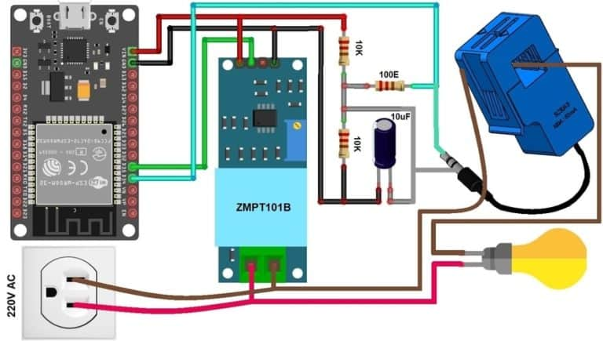
Architecture

Slide 13
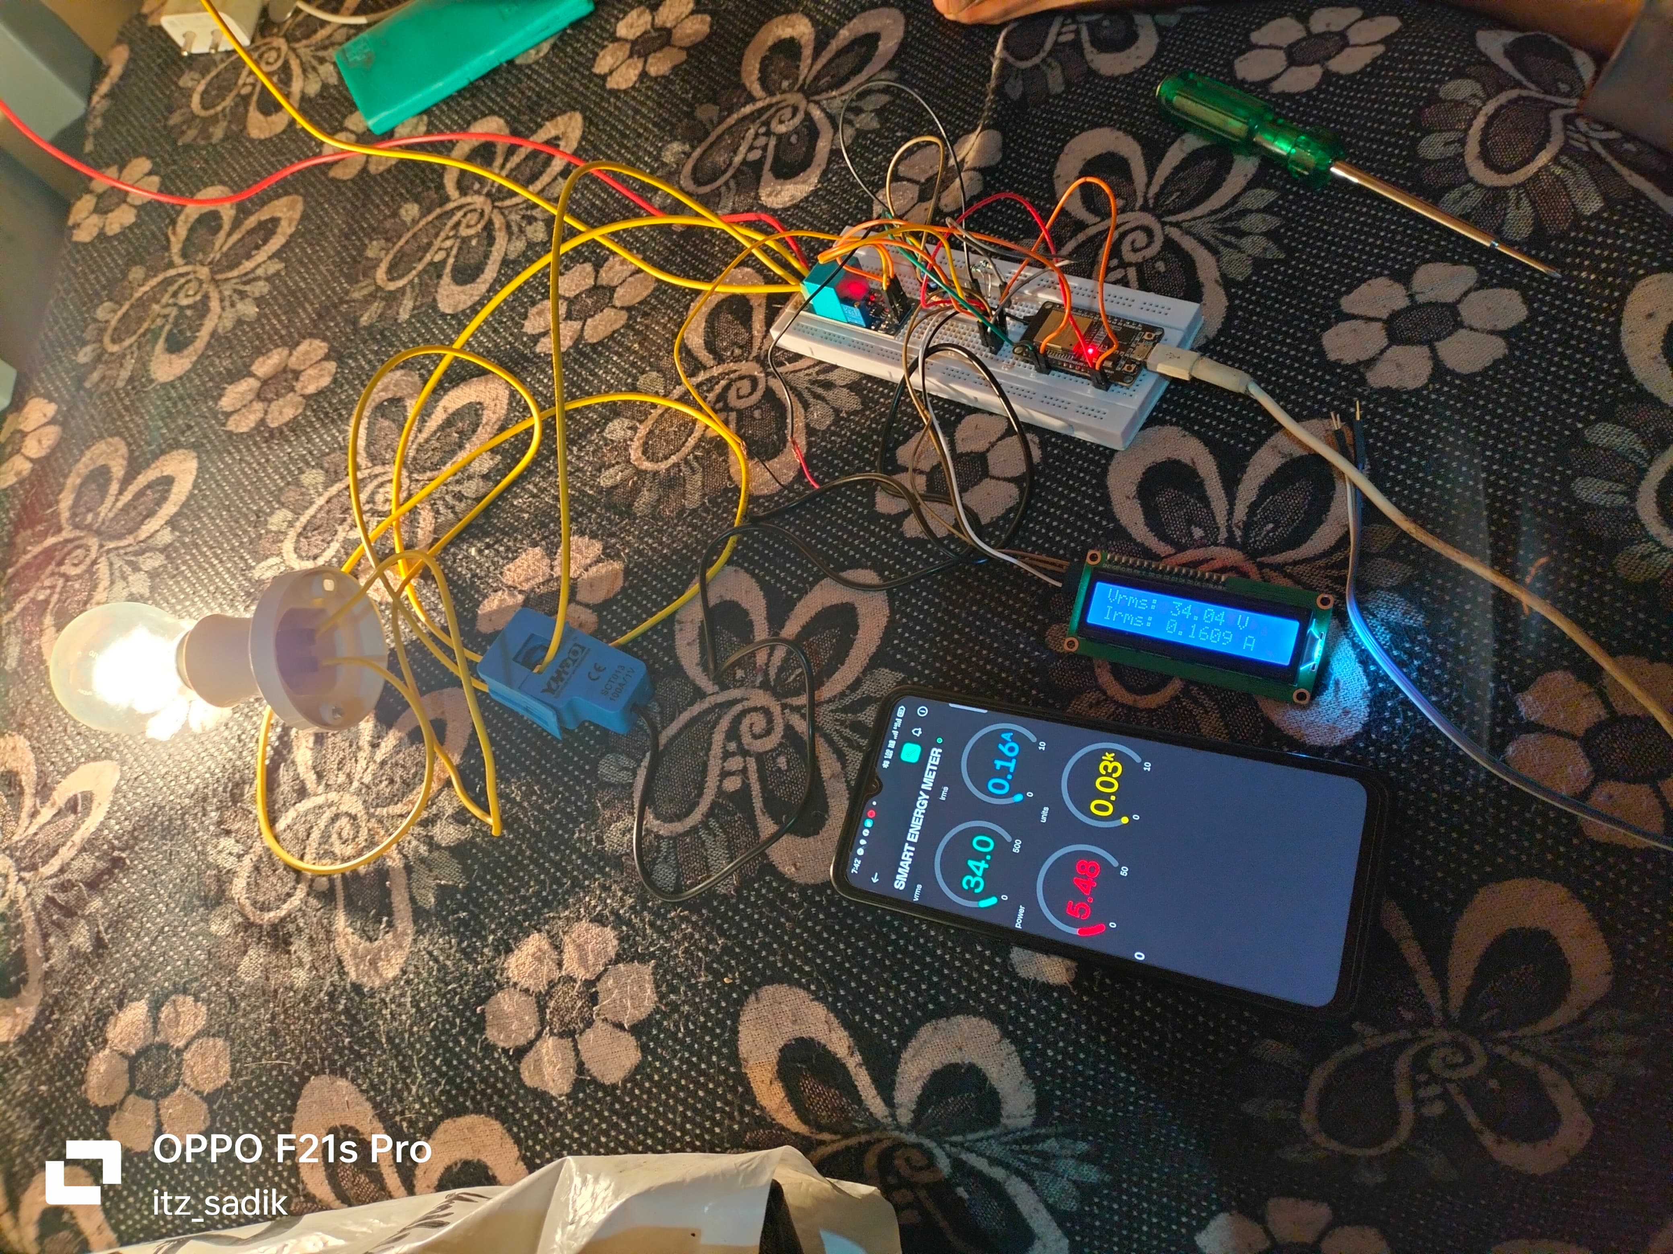
Implementation and Results – Iteration 1
Iteration 1 : Results
13

Slide 14
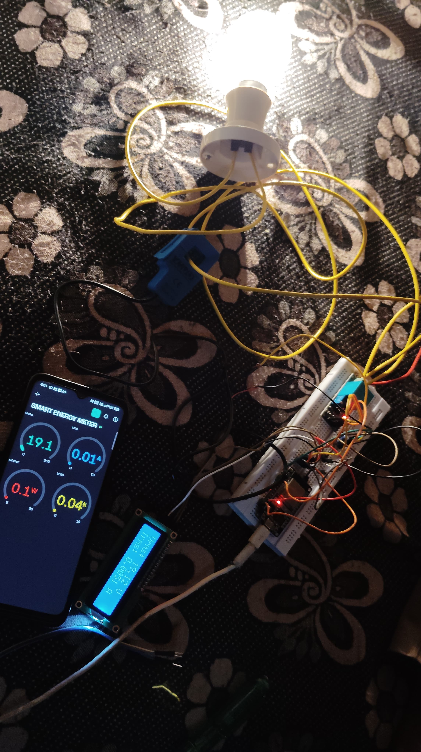
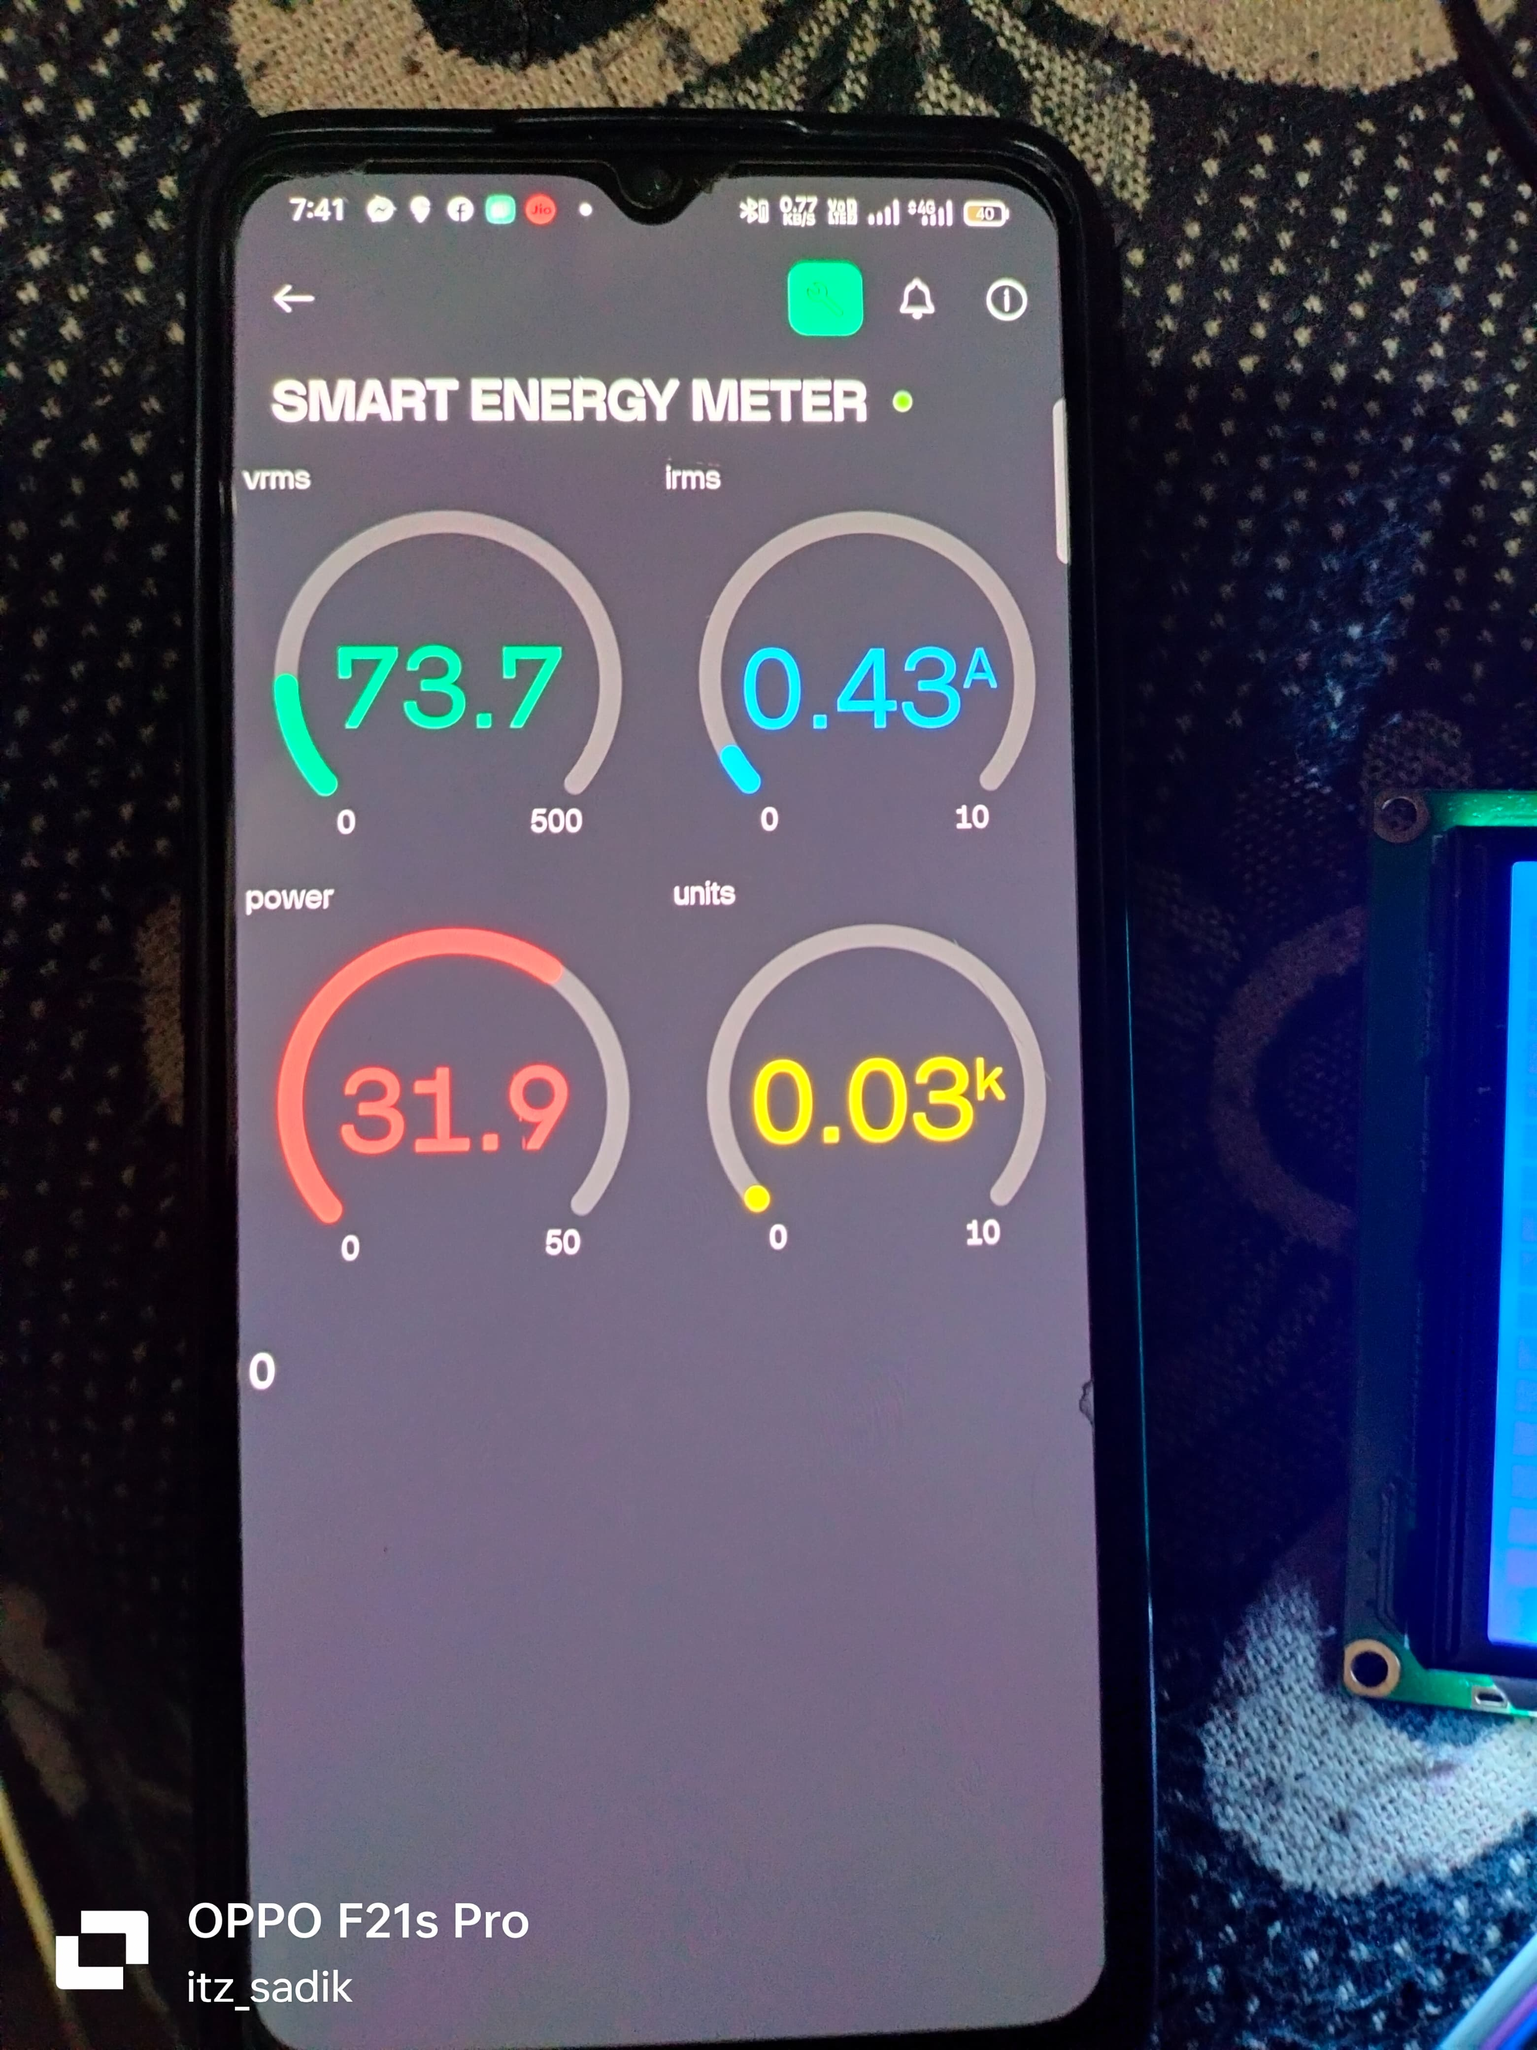
Implementation and Results – Iteration 2
Iteration : Results + Validation against the usecases and test cases

Slide 15
Contribution
Team Progress and Movement
Planning and Research (Completed)
Hardware Development (Completed)
Testing and Validation (Completed)
Documentation and Reporting (Completed)
Movement:
Interactive sessions with project guide.
Group discussions.
Individual Contribution
Key contributions: Sudeep B S
Prototype design
Cloud configuration
Coding (combined working)
Key contributions: Lakshman B H
Sensors and Prototype Testing
Purchasing components
Final PPT and Report
Key contributions: Darshan D M
Block diagram
Hardware setup
Sensor efficiency testing
15

Slide 16
Conclusion & Future Work
Conclusion
The Smart Energy Meter using successfully modernizes traditional energy metering by enabling real-time monitoring, accurate billing, and remote data transmission. It empowers consumers to track and manage their electricity usage more efficiently while providing utility providers with better control, reducing human error, and minimizing energy theft. This system sets the foundation for future advancements like IoT integration and renewable energy compatibility, making it a scalable and efficient solution for smarter energy management and sustainability. Overall, it contributes to a more reliable, user-friendly, and efficient energy infrastructure.
Future Work
IoT platform integration for cloud-based monitoring and remote energy management.
Mobile app development to enable users to track and control energy usage from anywhere.
Renewable energy monitoring for solar and wind energy to support green energy sources.
AI-driven analytics for predicting consumption patterns and optimizing energy usage.
Dynamic pricing models to help users reduce costs by utilizing off-peak energy rates.
Enhanced data security to protect user information and energy usage data.

Slide 17

THANK YOU

